Slide 1
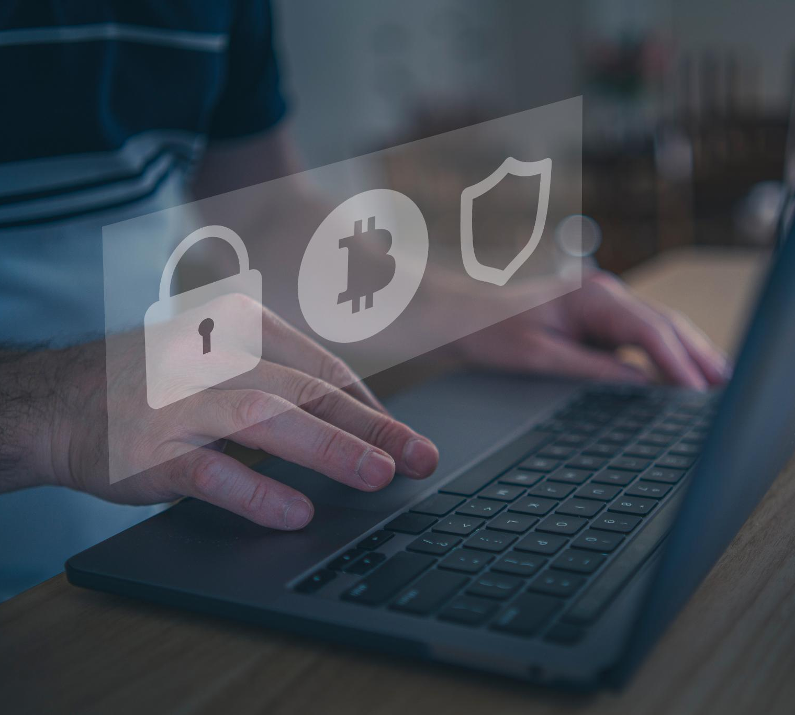
5.1 In-Class Activity Cybersecurity Training Guide for Employees
Essential practices to protect company data and systems
Presentation by:
Victor Menagarcia/Marc Foletia/Cameron Maccrea
Notes:
AI-generated content may be incorrect. ---

Slide 2
Introduction to Cybersecurity Awareness
Notes:
Why Cybersecurity Matters to Our Company

Slide 3
Understanding Malware
Notes:
Overview of Common Malware Types

Slide 4
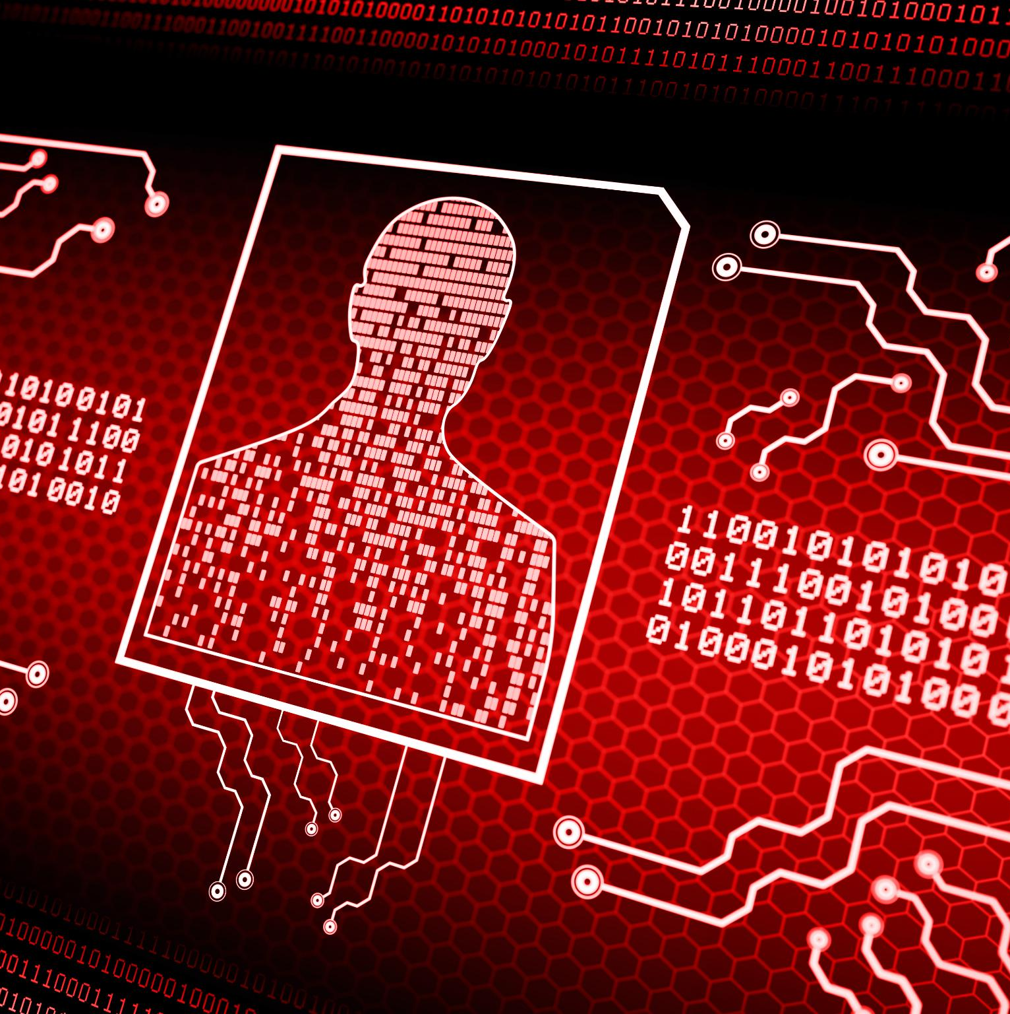
Overview of Common Malware Types
Viruses and Their Impact
Viruses attach to files and spread, corrupting data and slowing down systems, harming business productivity.
Ransomware Disruption
Ransomware encrypts files or locks systems, demanding payment and causing major operational disruptions.
Spyware Surveillance
Spyware secretly monitors user activity, capturing sensitive data like passwords for malicious use.
Malware Entry Points
Malware often enters via phishing emails, malicious attachments, unsafe downloads, and infected devices.
Notes:
Malware, short for malicious software, refers to programs designed to harm computers, networks, or data. Among the many forms of malware, three of the most common and dangerous for businesses are viruses, ransomware, and spyware. A virus is a type of malware that attaches itself to legitimate files or programs and spreads when those files are opened or shared. Viruses can corrupt data, damage systems, and significantly slow down computers, reducing productivity. Ransomware is one of the most disruptive forms of malware because it encrypts files or locks users out of their systems and then demands payment in exchange for restoring access. Even paying the ransom does not guarantee data recovery, making prevention and backups essential. Spyware operates quietly in the background, monitoring user activity without consent. It can record keystrokes, capture passwords, and collect sensitive business or personal information, which can then be used for identity theft or further attacks. These malware types often enter systems through phishing emails, malicious attachments, unsafe downloads, compromised websites, or infected USB devices. Understanding how each type behaves helps employees recognize warning signs early and avoid actions that could introduce malware into the company environment.

Slide 5
Malware Prevention Fundamentals
Notes:
General Best Practices for Preventing Malware

Slide 6
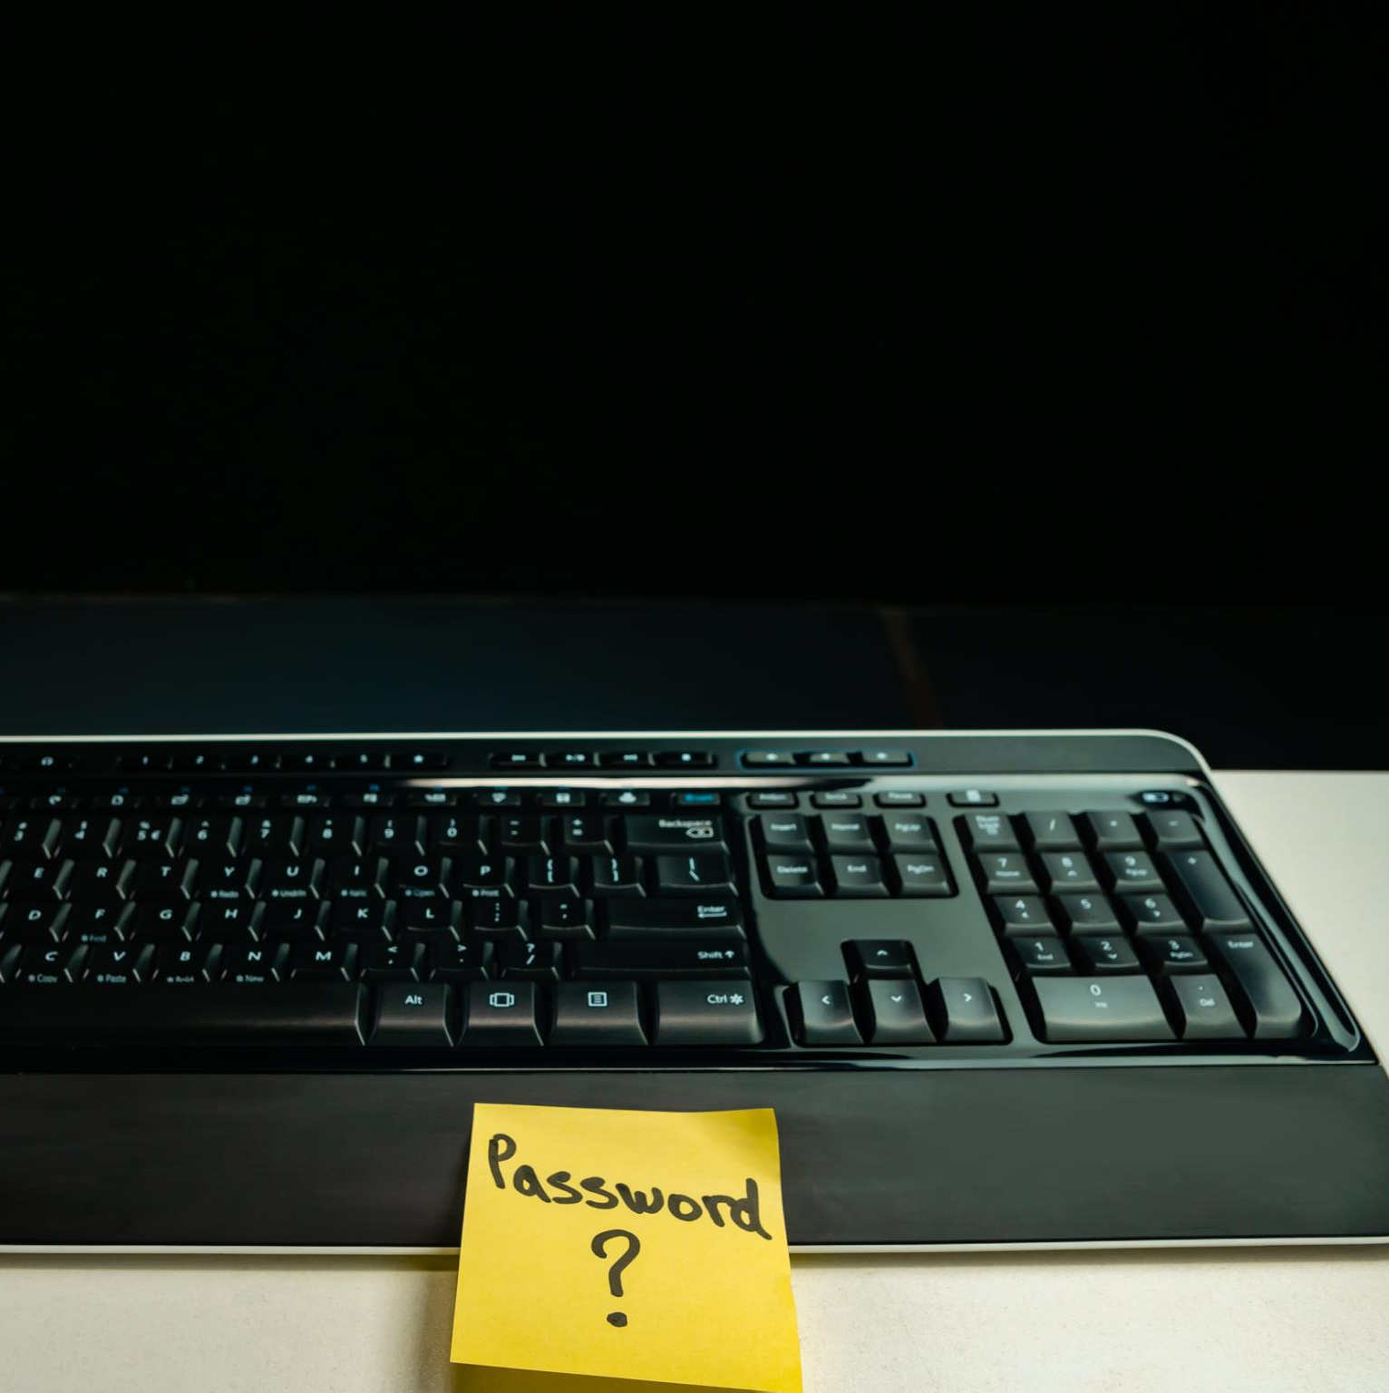
General Best Practices for Preventing Malware
Email Vigilance
Be cautious with emails from unknown senders and avoid clicking suspicious links or attachments.
Strong Passwords
Use unique, complex passwords and never reuse them across personal and work accounts.
Regular Updates
Keep operating systems, applications, and browsers up to date to patch security vulnerabilities.
Use Trusted Sources
Download software and files only from trusted sources and avoid unauthorized external devices.
Notes:
Preventing malware begins with consistent, everyday security habits that apply to all types of threats. One of the most important practices is being cautious with emails, especially those from unknown senders or messages that create urgency, such as unexpected invoices or requests for immediate action. Employees should never click on suspicious links or open attachments unless they are confident the message is legitimate. Strong password practices are another key defense. Passwords should be unique, complex, and never reused across work and personal accounts. Keeping operating systems, applications, and browsers up to date is essential, as updates often include security patches that fix known vulnerabilities. Antivirus and endpoint protection software must remain enabled and updated to detect and block known malware threats. Employees should only download software or files from trusted, approved sources and avoid using unauthorized USB drives or external devices. Secure internet habits, such as avoiding unprotected public Wi-Fi for work tasks, further reduce risk. When combined, these general best practices create multiple layers of protection that significantly lower the chances of malware successfully infecting company systems.

Slide 7
Preventing Specific Malware Types
Notes:
Preventing Viruses, Ransomware, and Spyware

Slide 8
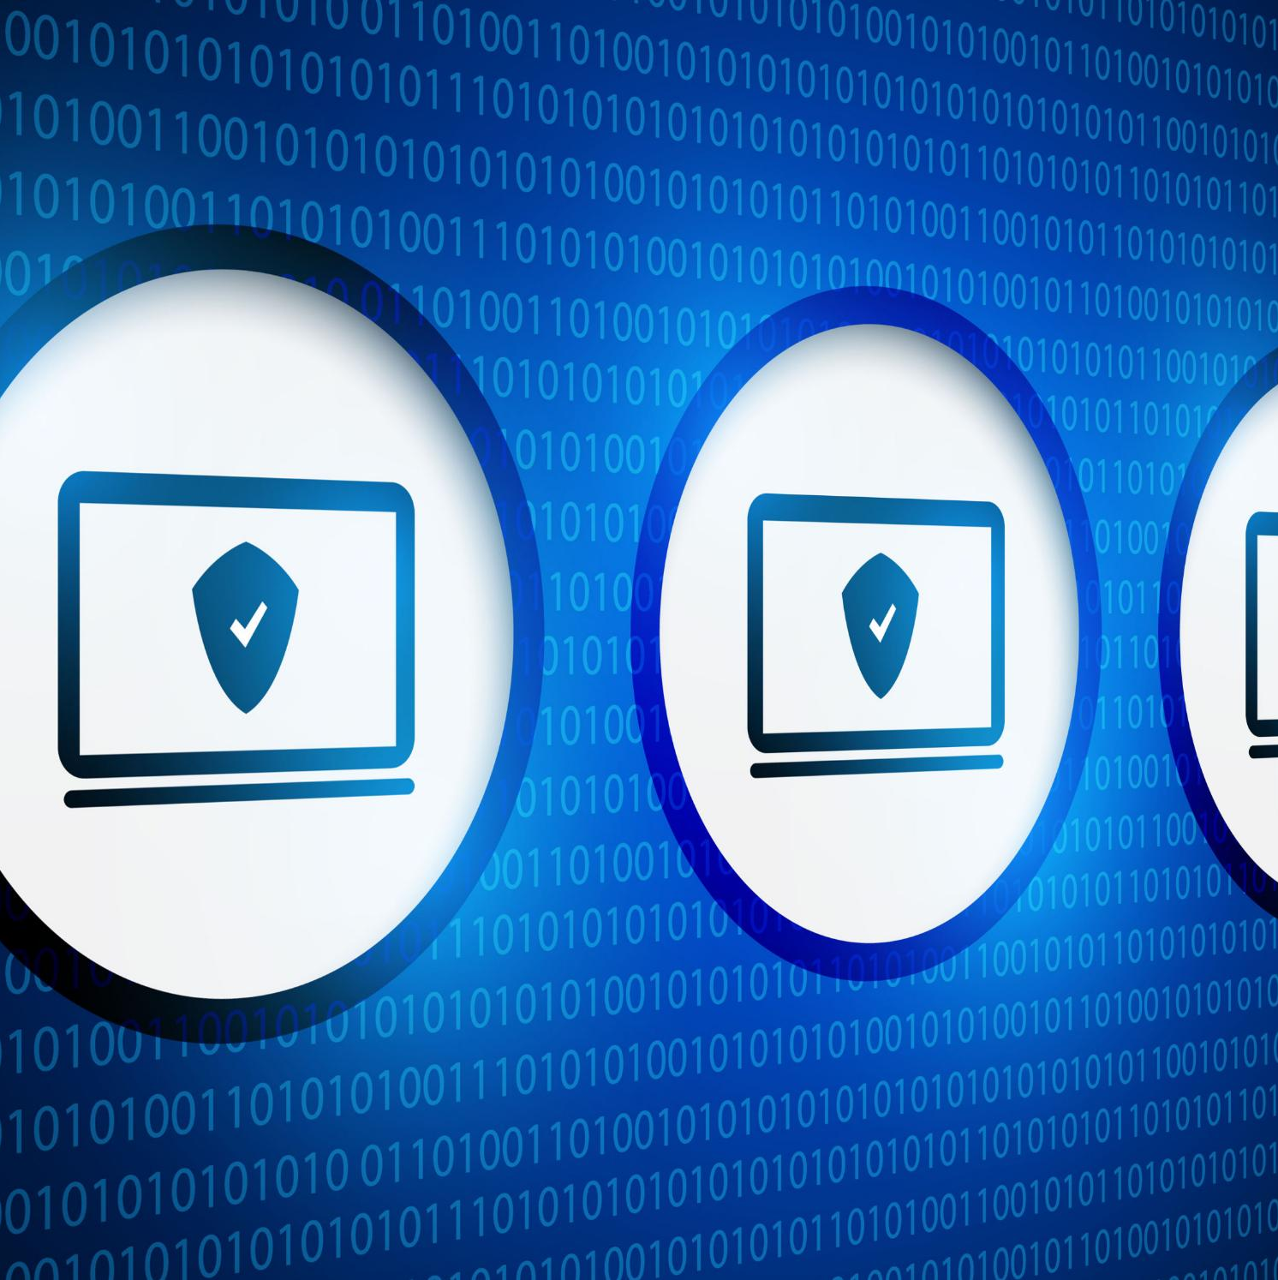
Preventing Viruses, Ransomware, and Spyware
Virus Prevention
Avoid downloading files from untrusted sites and scan files before opening to prevent viruses. Do not connect unknown USB devices to company computers.
Ransomware Prevention
Focus on email awareness by avoiding suspicious attachments and links. Regularly back up data in cloud or offline storage to recover from ransomware.
Spyware Prevention
Install only approved software and review permissions carefully. Avoid free or pirated software and use secure networks to reduce spyware risks.
Notes:
While general security habits are important, understanding how to prevent specific malware types adds another layer of defense. To prevent viruses, employees should only download files from trusted websites, scan files before opening them, and avoid connecting unknown USB devices to company computers. Viruses often rely on users unknowingly activating infected files, so caution is critical. Preventing ransomware requires a strong focus on email awareness and data backups. Employees should be especially wary of unexpected attachments or links, even if they appear to come from known contacts, and report anything suspicious to IT immediately. Regular backups, whether cloud-based or offline, ensure that critical data can be restored without paying a ransom. Spyware prevention focuses on controlling what software is installed and what permissions are granted. Employees should only install applications approved for business use, carefully review permission requests, and avoid free or pirated software that may contain hidden tracking components. Using secure networks and logging out of systems when not in use also helps reduce exposure. By applying targeted prevention strategies for each malware type, employees can significantly reduce the likelihood of successful attacks.

Slide 9
Responding to Suspected Malware Incidents
Notes:
What to Do If You Suspect an Attack

Slide 10
Conclusion and Shared Responsibility
Notes:
Staying Alert and Secure Every Day

Slide 11
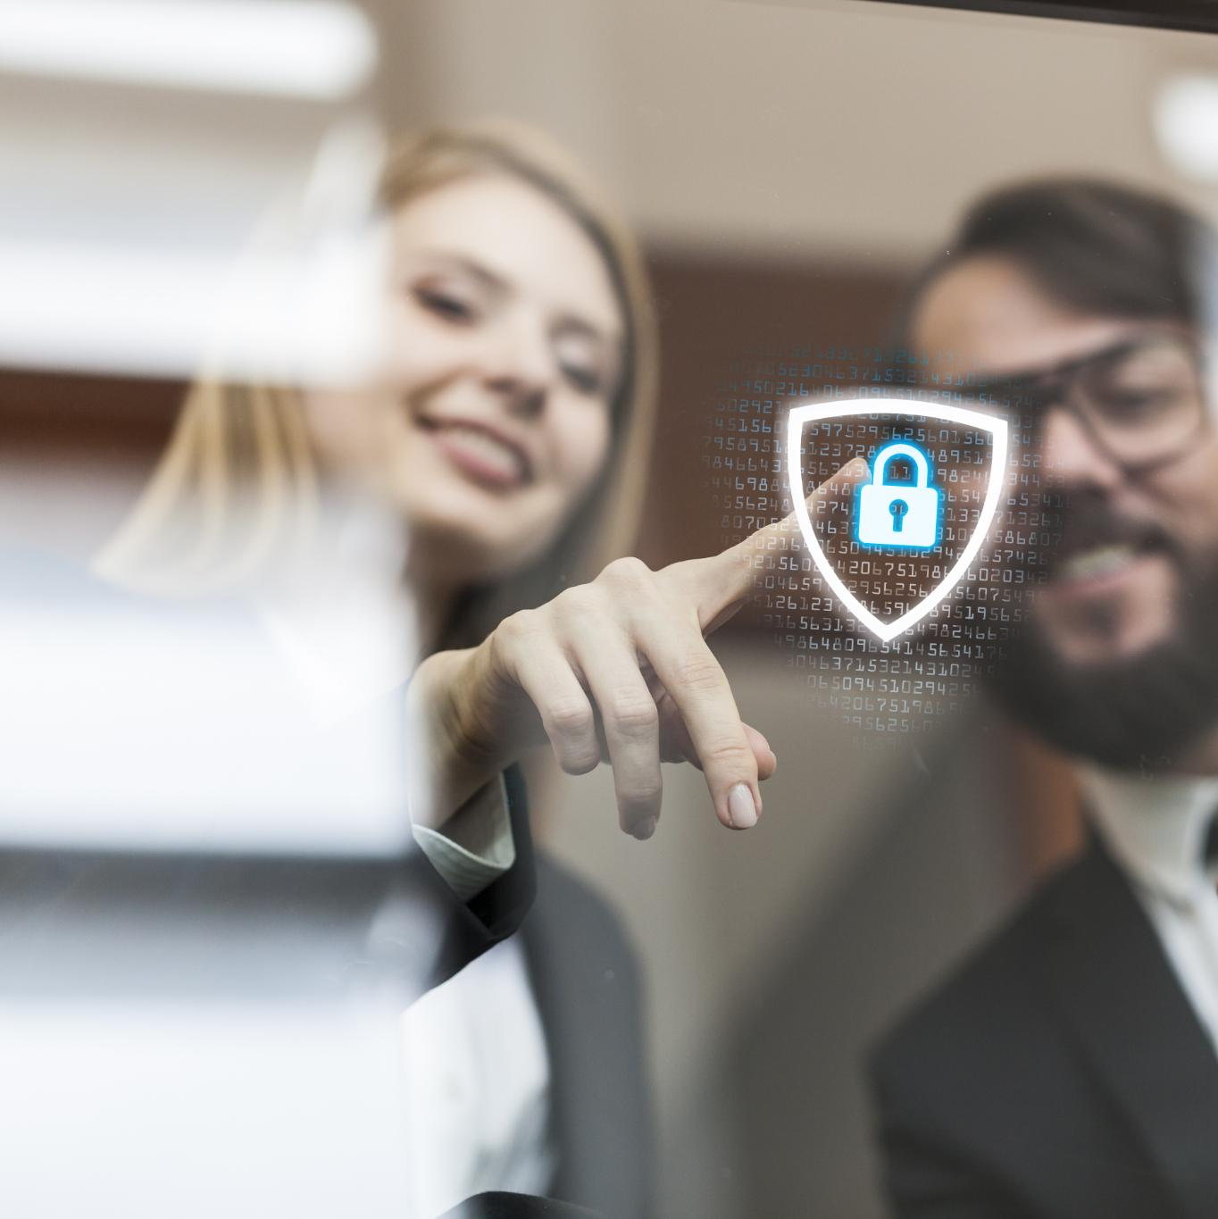
Staying Alert and Secure Every Day
Shared Security Responsibility
Cybersecurity requires commitment from every employee to protect systems, data, and company reputation.
Understanding Malware Threats
Recognizing malware types like viruses, ransomware, and spyware helps employees avoid risky behavior.
Best Practices and Rapid Response
Following security guidelines and reacting quickly to suspicious activity strengthens security posture.
Ongoing Awareness and Training
Continuous learning and staying informed about updates fosters a culture of security awareness.
End of Presentation
Notes:
Cybersecurity is not solely an IT responsibility; it is a shared commitment across the entire organization. Every employee plays a role in protecting company systems, data, and reputation. By understanding common malware types such as viruses, ransomware, and spyware, employees are better prepared to recognize threats and avoid risky behavior. Applying general security best practices, following specific prevention steps, and responding quickly to suspicious activity all contribute to a stronger security posture. Cyber threats continue to evolve, making ongoing awareness and caution essential. Employees are encouraged to ask questions, participate in future training, and stay informed about security updates and company policies. A culture of security awareness helps ensure business continuity, protects sensitive information, and reduces the risk of future cyber-attacks. Staying alert, informed, and proactive is the most effective way to keep our workplace secure.

